Slide 1







Quality, Diversity,
Faith, Flourishing
ST MARY THE VIRGIN CW PRIMARY SCHOOL
RECEPTION
2026
NEW PARENTS MEETING

Slide 2


Welcome and
Thank you!

Slide 3



Gates open at 8:50 a.m.
School starts at 8:55 a.m.
School Times
2 school gates:
  North Church Street (NO cars)
  Canal Parade (parking available)
We have a staggered start:
  Wed-Fri: finish at 11:30
  Following week finish at 12:30
  We will then review and communicate this with you

Slide 4


Class Teacher
Mrs Kate Parsons
Class LSA
Mrs Simran Kaur
WHO’S WHO?
Executive Head teacher
Mrs Abi Cuthbert
DHT/Acting Head teacher
Mrs Hannah Lakin
ALNCo
Mrs Danielle Egan

Slide 5


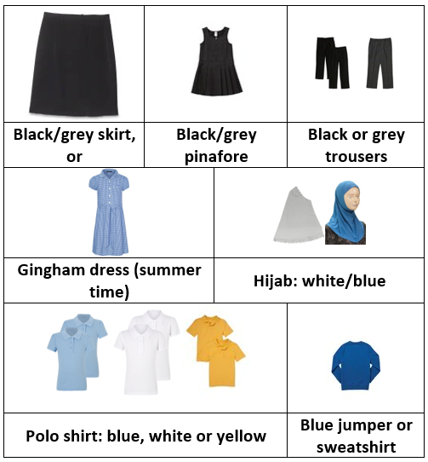


SCHOOL UNIFORM
We expect all children to wear School Uniform.
Hoodies are not allowed.
EMA Embroidery sells uniform with our School Logo
EMA Embroidery & Printing Ltd
59a Clare Road
Cardiff
CF11 6QP
029 2019 0110
www.emaembroideryprinting.co.uk
Name your child’s clothing! Please!

Slide 6

PE KIT
We expect all children to wear School Uniform.
Hoodies are not allowed.
ALL children from Reception to Year 6 MUST bring a PE kit to school to change into: shorts, leggings or joggers, a T-shirt and trainers.
If your child does not bring kit, we will put them into spare school kit.
Please don’t send your child to school in their PE kit.
Your child can bring their kit to school each Monday, and then take it home each Friday to be washed.
Name your child’s clothing! Please!
EMA Embroidery sells uniform with our School Logo
EMA Embroidery & Printing Ltd
59a Clare Road
Cardiff
CF11 6QP
029 2019 0110
www.emaembroideryprinting.co.uk

Slide 7


Ambitious, capable learners
What we Learn
  Ready to learn throughout their lives
  able to set high standards for themselves and enjoy challenge
  Equipped with knowledge and skills to apply in different contexts
Enterprising, creative contributors
4 purposes
  Ready to play a full part in life and work
  Able to think creatively and solve problems
  Willing to take measured risks and lead responsibly
Ethical, informed citizens
  Ready to be citizens of Wales and the world
  Knowledgeable about their culture, community and the wider world
  Respectful of others and committed to sustainability and human rights
Healthy, confident individuals
  Ready to lead fulfilling lives as values members of society
  Emotionally and physically well
  Resilient, empathetic and able to form positive relationships

Slide 8
Languages, Literacy & Communication
What we Learn
Reading, speaking, writing, and thinking comprehension techniques and methods.
Mathematical Development
Exploring the world of numbers, shapes and patterns through play based hands on learning. Goal is to build a strong foundation in mathematical thinking and confidence.
6 AoLEs
Health & Wellbeing
Begin to understand how to take care of themselves and others - physically, emotionally and socially. Helps build foundations for a happy, healthy life.
Expressive Arts
Exploring creativity and imagination through music, dance, drama and visual arts. All about expressing themselves, experimenting and enjoying the process of creating.
Humanities
Begin to understand the world around them - past and present, near and far. Includes history, geography, religion, values and ethics all explored through stories, play and real life experiences.
Science & Technology
Begin to explore how the world works through curiosity, investigation and problem solving, helping develop early scientific thinking and introducing to basic technology in fun, hands on way.

Slide 9




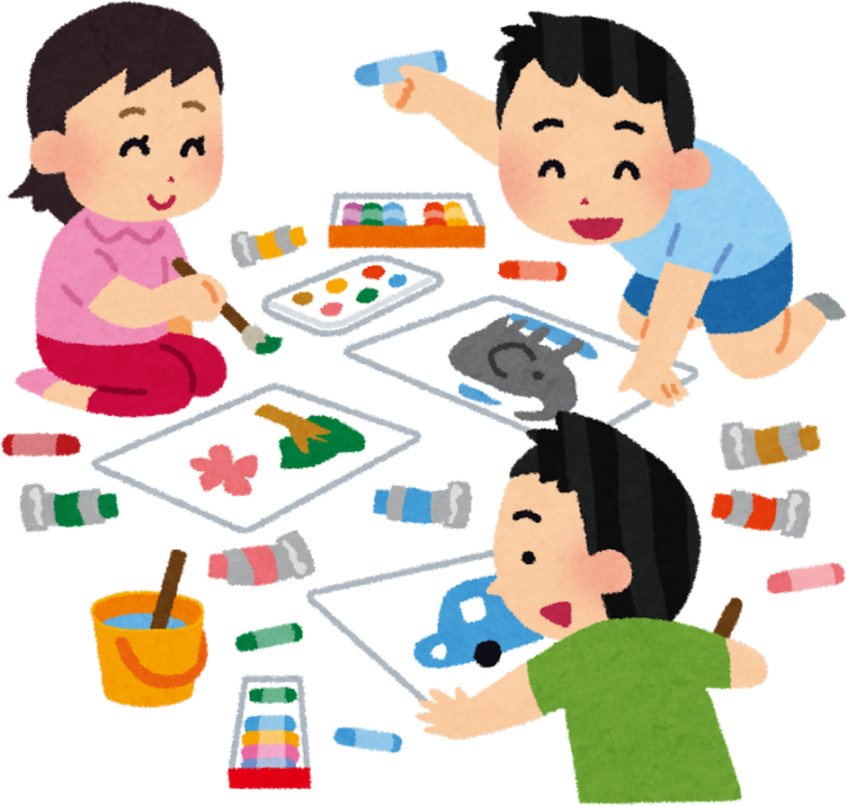



How we Learn

Slide 10
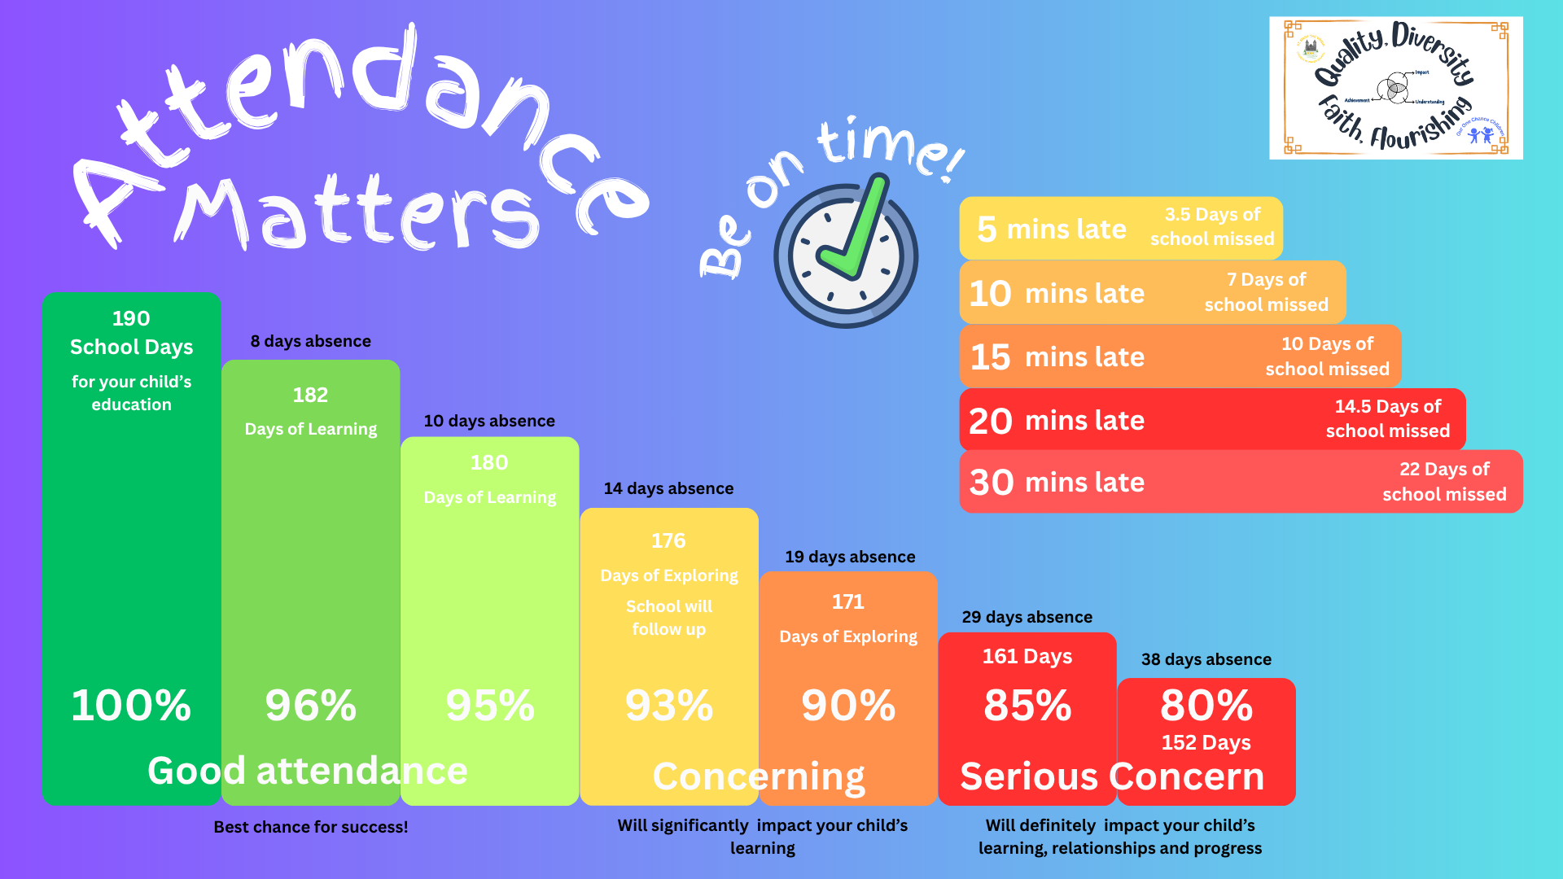

Slide 11



School Meals
All Primary age pupils are entitled to Free School Meals. These MUST be prebooked using ParentPay.
You will be given a letter to sign up for ParentPay.
School Essentials Grant
If you are on a low income or certain benefits, you can apply for the School Essentials grant - £125 per child.
School also receives just over £1,000 into our budget as well! We need it!

Slide 12
Food and Drink
Snack
Water
Similar to Nursery - rolling snack.
£1 per week, payable to the school office.
Milk also provided - must be drunk unless allergies.
All children need to bring a reusable water bottle each day.
We have no metal water bottles for safety reasons; also no Stanley cups.
School Dinners
Children eat their school dinners in the hall with other Foundation Phase classes. It is helpful if you teach your child to use a knife and fork.
All meat served is Halal.
Packed Lunches
Packed lunches must be healthy.
No fizzy drinks or cold takeaways.
No nuts (including Nutella).

Slide 13



Food and Drink
School Dinners
Packed Lunches
Children eat their school dinners in the hall with other Foundation Phase classes.
It is helpful if you teach your child to use a knife and fork.
All meat served is Halal.
You may wish to send your child with a packed lunch.
Please make sure:
  the lunch box/bag is a suitable size (not too big!)
  The food is healthy - not a cold takeaway. Also, no sweets!
  There are no nuts - we are a nut free school
  The drink is either water or squash - no fizzy drinks or cans of drinks

Slide 14





COMMUNICATION
1
2
3
Schoop - have you signed up? And linked to your child’s class?
Seesaw - parent and children’s accounts
Telephone
Do we have your correct telephone number?
4
5
Please keep school up to date with all of your current contact details. Thank you!
Email
Do we have your correct email address?
Home address
Do we have your correct home address?

Slide 15


COMMUNICATION
My child has an appointment
I want to see what my child is learning
Let the school know - Schoop, email or phone call.
If you are collecting your child early, please make sure school knows.
I think my child may have additional needs
Log into your child’s Seesaw to see. You can also upload images yourself.
Speak with your child’s class teacher or Mrs Egan (ALNCo) to discuss your concerns.
My child can’t come to school
Please keep school up to date with all of your current contact details. Thank you!
I want to meet with my child’s teacher
Let the school office know - Schoop, email or phone call
Any other questions?
Contact the school or message the teacher to make an appointment.

Slide 16
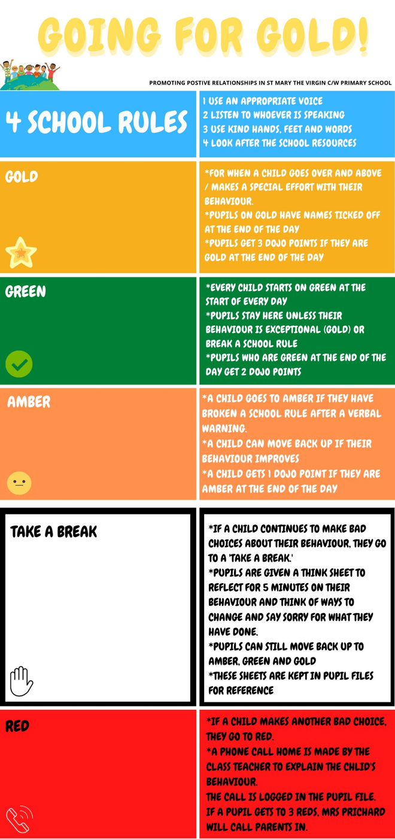


Positive Relationships
We will help you by ...
  Making sure children are at the heart of all of our decision making
  Providing a range of authentic and interesting learning experiences
  Keeping you informed about your child’s progress
  Discussing any concerns with you promptly
You can help us by ...
Greet your child with a smile
  Making sure your child has a good night’s sleep
  Making sure your child has a good breakfast (or comes to Breakfast Club)
  Bringing your child to school on time
  Collecting your child on time
  Actively greeting your child at the end of the day - with a smile, not a mobile!
  Letting us know if there are any home issues that may affect your child’s behaviour, wellbeing or learning
  Informing us of any concerns you may have about your child’s progress or safety at school
NOT a mobile

Slide 17




Zones of Regulation
No ‘bad’ Zone - all emotions are valid.
Zones helps children manage feelings & behaviours
What are the Zones of Regualation?
Teaches us:
  vocabulary of emotional terms
  how to recognise own emotions
  how to detect the emotions of others
  what might trigger certain emotions
  How others might interpret behaviour
  problem solving skills
sad
sick
tired
bored
worried
frustrated
silly
excited
Why teach the Zones of Regulation?
  Provides a common language to discuss emotions - a language that is non-judgemental
  The Zones of Regulation is simple for children to understand but is helpful for ALL!
  The Zones teach healthy coping and regulation strategies
in control
calm
happy
angry
wild
terrified

Slide 18


WHAT TO BRING
PE Kit on Mondays (take home on Fridays)
Coat with a hood - if cold or wet
Book Bag
A big smile!
Reusable water bottle - with child’s name on. Make sure they have seen it before school
Lots of energy!

Slide 19






Our Contact Details
029 2048 1608
stmarythevirginprm@cardiff.gov.uk
www.stmarythevirginprm.co.uk
@smtvcardiff
Schoop ID 17408

Slide 20

School Nursing Team
During the year your child will have the following tests by the School Nursing Team:
  Hearing Test
  Height, weight and sight

Slide 21
OPEN FORUM
QUESTIONS?

Slide 22
THANK YOU!

